Slide 1
23MX23 - Object Oriented Programming using JAVA Basics of JAVA (CO-1)
Dr. Ilayaraja N
PSG Tech

Slide 2


Slide 3


Slide 4


Slide 5


Slide 6


Slide 7


Slide 8


Slide 9


Slide 10
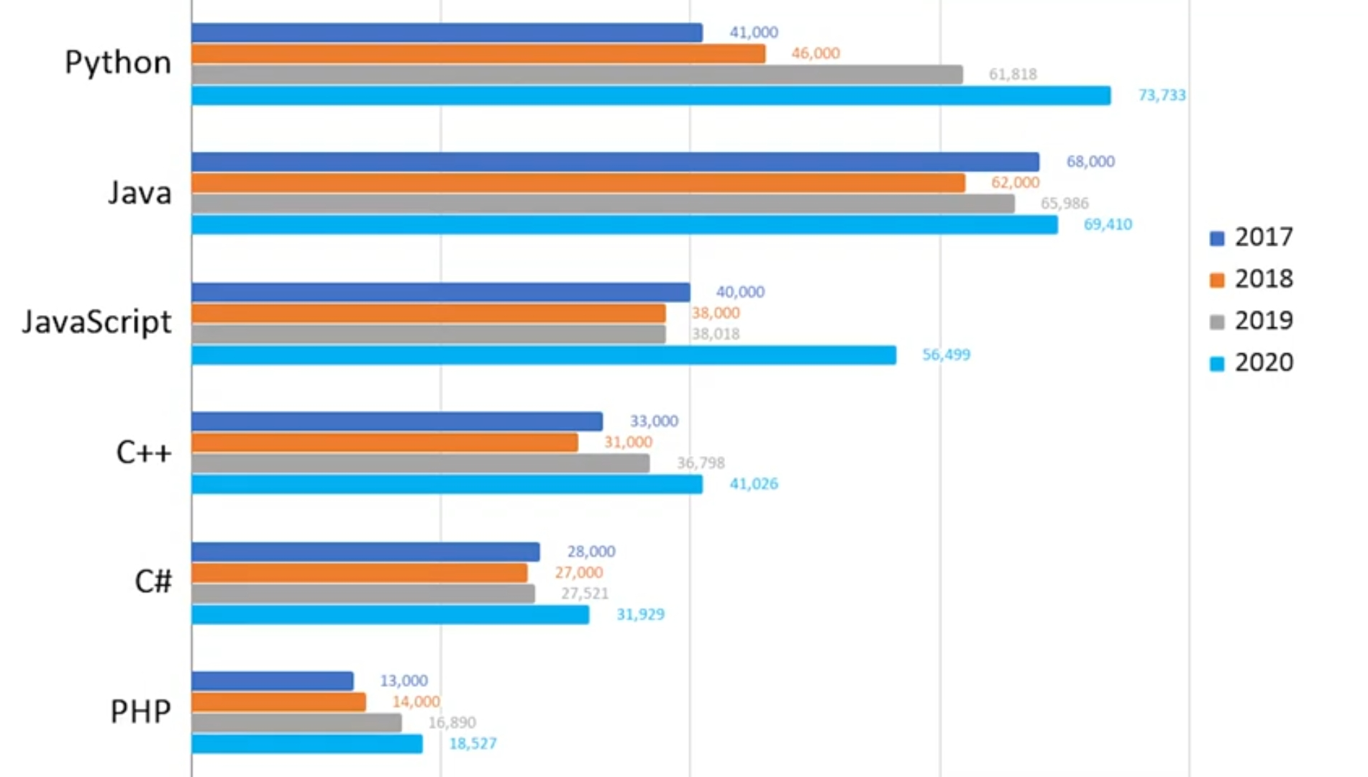

Slide 11
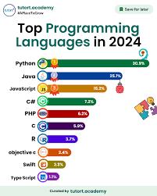
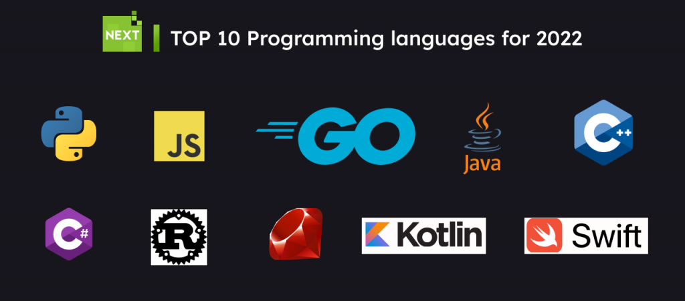

Slide 12
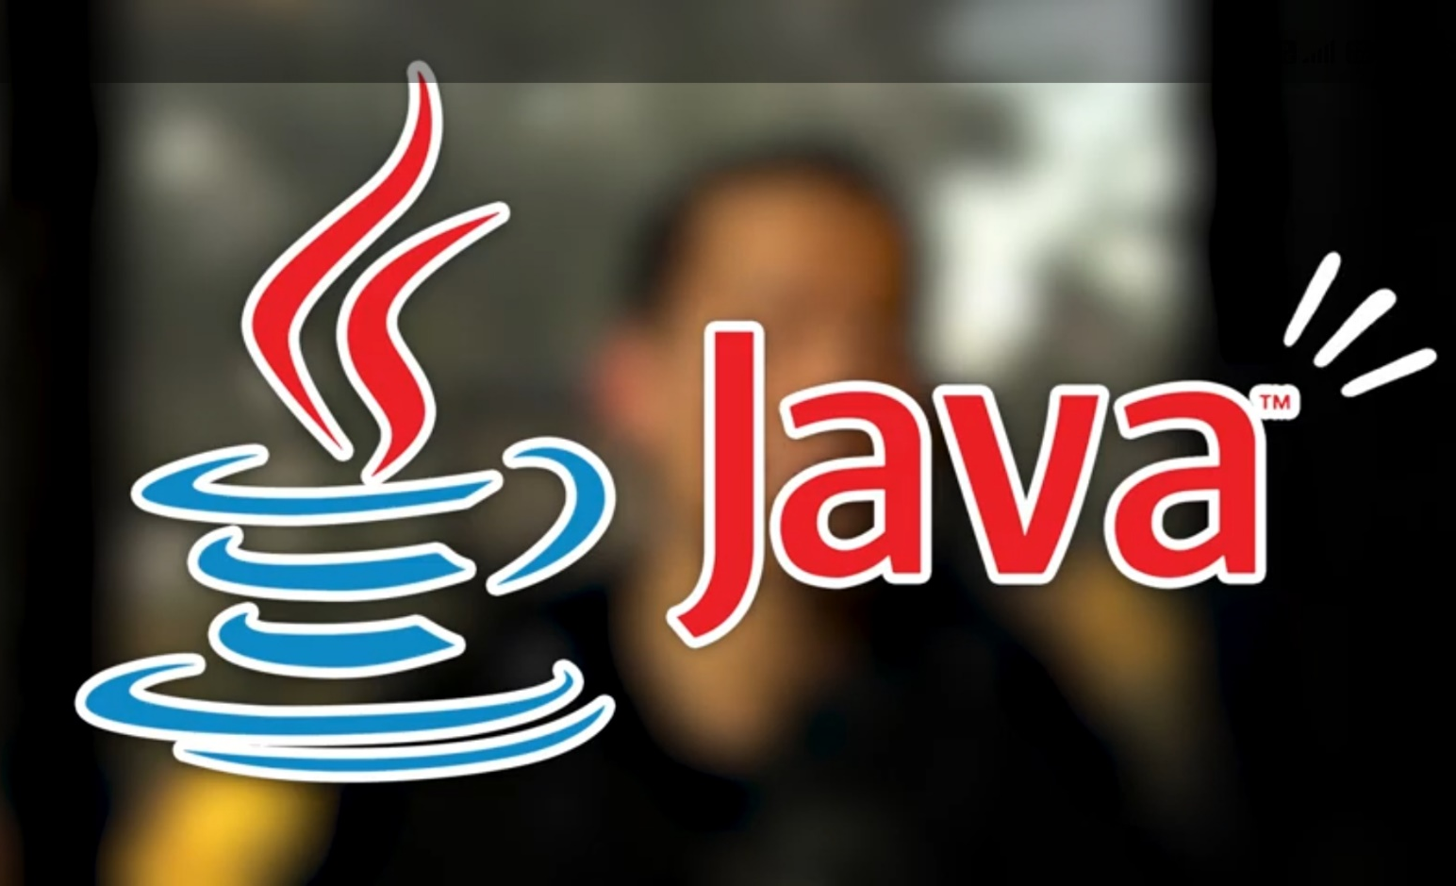


Slide 13
Why JAVA?
Sustaining a place in the list of top five programming languages every year, in the era where programming languages and technologies are booming, is not a simple task.
And Java has accomplished this pretty easily. This year, 2024, marks the 29th anniversary of the multi-faceted programming language.
Still, the craze it carries remains unbeaten!

Slide 14
Why JAVA?
Birth name as Oak, named after an oak tree that stood outside its creator James Gosling’s office, later called as Green, ‘Java’ is the third name for the programming language.
Designed in line with C/C++ in style and syntax, Java became popular very soon among the developer and programming community owing to many of its unique and useful features.

Slide 15
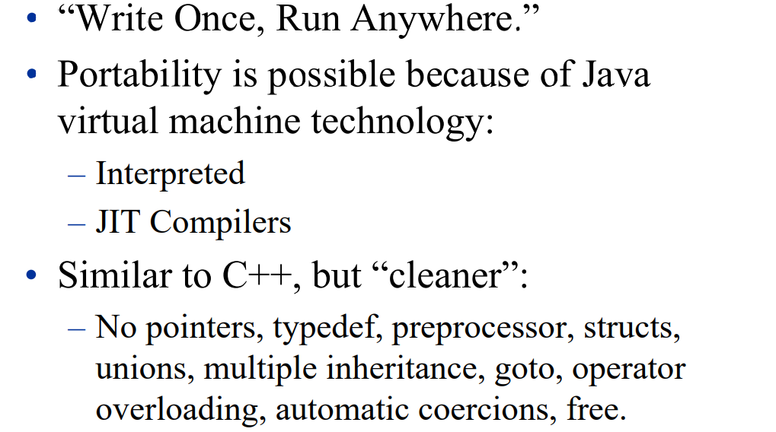
Why JAVA?

Slide 16
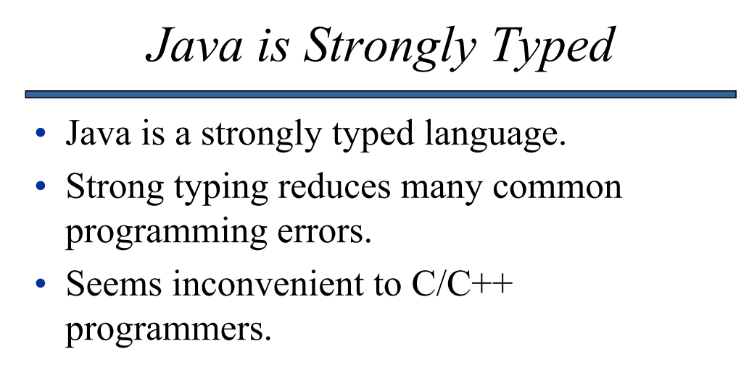
Why JAVA?

Slide 17
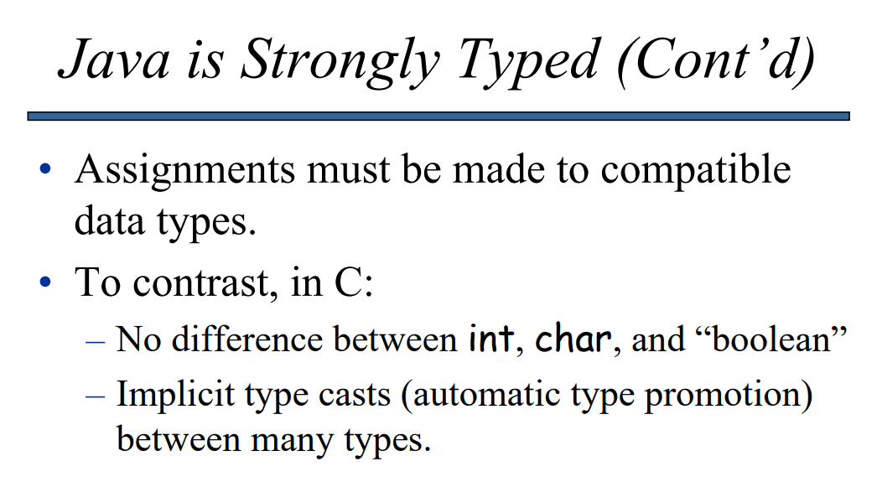
Why JAVA?

Slide 18
An Object-Oriented Programming Language
Java, which has been designed entirely having OOP at its core, just made this concept much more attractive.
OOP offers clear modular structure, makes code reusable, eases maintenance of the code and speeds up the process of development.
OOP also increases the productivity of the programmer and offers flexibility to choose from rich inbuilt libraries.
Java provides abstraction, encapsulation, polymorphism, and inheritance, besides offering many design patterns and best practices to programmers.

Slide 19
An Omnipresent
As per the latest stats, there are more than 3 billion devices that are running primarily on Java. Android apps, web applications, software tools such as Eclipse, IntelliJ IDEA, and NetBeans IDE, scientific applications such as natural language processing are all being developed in Java.
Java opens up opportunities to choose from a myriad of proven career paths.

Slide 20
User-Friendly Language
Java provides a simpler learning path.
If a user is familiar with installing JDK and setting up Classpath, the rest is just a cakewalk.
As James Gosling mentioned, “Java is C++ without the guns, clubs, and knives”, which means if the learner has a basic knowledge of C and C++, it takes lesser time to master Java.

Slide 21
A Not to Miss Technology for IoT, Machine Learning and Data Science
One big advantage with Java is that it offers the ultimate platform for developing code that is multi-platform compatible.
And this is exactly what data science needs.
Secondly, Scala is one of the technologies that programmers have to use to build big data processing and machine learning solutions.
However, Scala is not that beginner friendly, many programmers are happily using Java in its place, as essentially Scala is built on JVM and goes well with Java.
Also, if a developer has expertise in Java, it is easy for him to learn Hadoop or Hive, which are the other technologies needed for working with grid computing and machine learning.
Java’s Micro Edition (ME) has proven to be a reliable and convenient platform to create Internet of Things (IoT) based applications too.

Slide 22
Rich in API
Java’s Application Programming Interface (API) is extensive and rich.
Though the language contains 50 keywords, the Java API is enormous with hundreds of methods that can be directly used in any program.
The Java API contains methods that are needed for every purpose: connecting to databases, parsing XML, dealing with input-output, or networking.
Additionally, a programmer can also make use of open source libraries such as Google Guava, Gson, Apache POI or Apache Commons.

Slide 23
Offers a Package of Powerful Development Tools
Java is unique in another aspect: its Integrated Development Environment (IDE) is all comprehensive.
It includes many automation tools, editor and debugger.
Among the developers’ community, Java IDEs NetBeans and Eclipse are very popular.
Other powerful tools that Java offers include Maven and ANT for building Java applications, decompilers, JConsole, Visual VM for monitoring Heap usage and Jenkins for Continuous Integration and delivery.

Slide 24
The Number One in Community Support
Another reason why Java enjoys a vibrant and active programming language status because of the huge community support too.
It is also the second largest among the Stack Overflow community, which shows its immense popularity and user-base.

Slide 25
Widely Used by Industry Giants
Ranging from Macintosh, Unix/Linux, mainframe systems, Windows and mobile phones, Java’s Run Time Environment (JRE) is beautifully compatible with any existing devices.
This is because Java is platform independent and all it needs it its JRE installed on the device that you want to run the application on. And yes, you are good to go!
Many of the industry giants in banking, retail sector, and utilities — all use Java even as of today. Java’s “Write Once Run Anywhere” (WORA) feature has made all these possible!

Slide 26
Free and Excellently Documented
A programmer need not pay a penny to create an application in Java. It is an open-source technology, free to use and implement.
Besides, the documentation that is provided with Java is well-explained and has all the features that make a beginner fall in love with learning with Java.
Javadoc is an excellent help guide to refer in case of any clarifications needed while coding in Java.

Slide 27
Bottom line: slow but safe ie. Very safe
Not suitable for high-performance computation Scientific computation, games, OS kernel Compiled to byte codes of JVM, not native machine language instructions.
New release of Java is improving the speed a lot
Just-in-time (JIT) compiler: convert byte codes to native machine language on the fly
Very safe
No pointer
Automatic garbage collection
Check array access bound
rich pre-defined class library

Slide 28
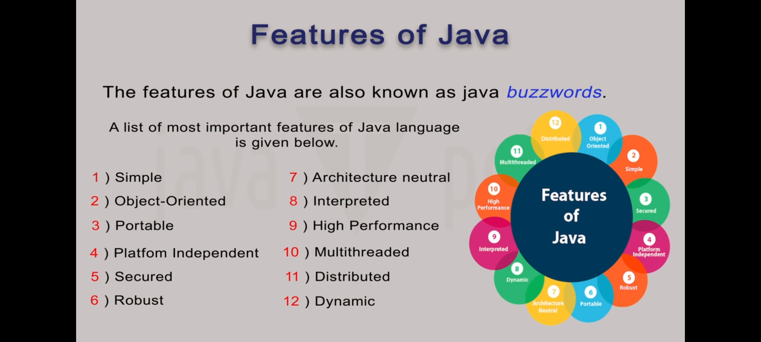

Slide 29
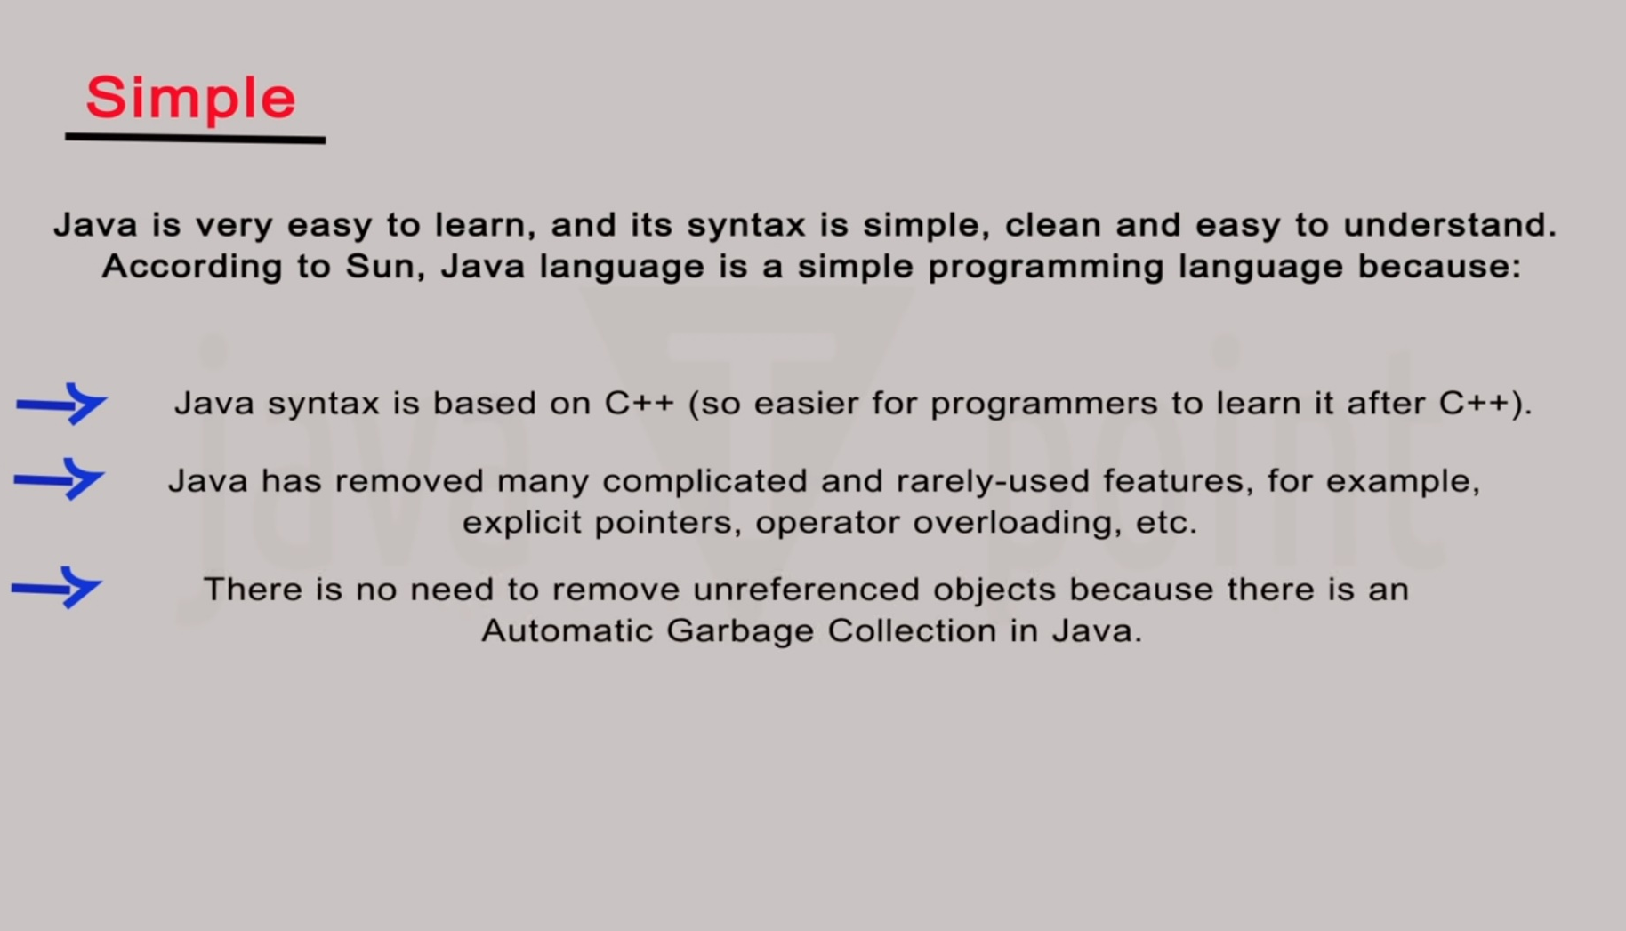

Slide 30
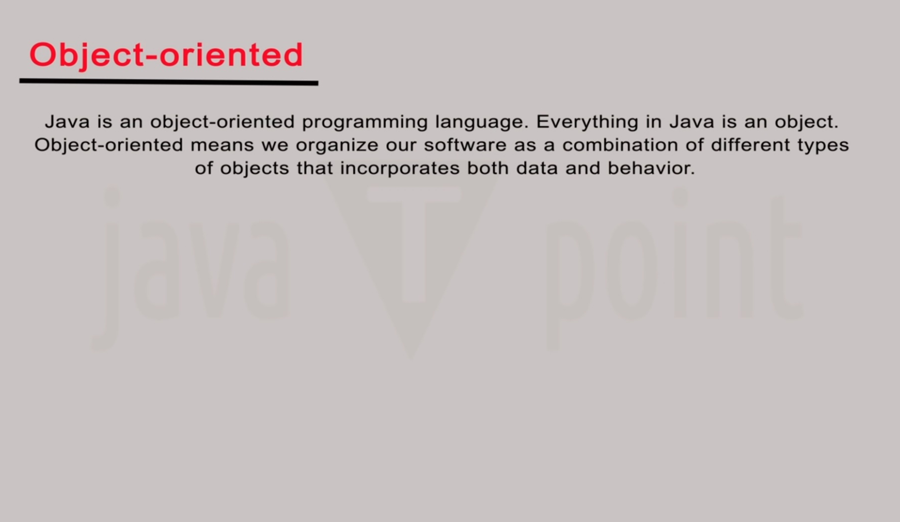
focus on the data (objects) and methods manipulating the data
all functions are associated with objects
almost all datatypes are objects (files, strings, etc.)
potentially better code organization and reuse

Slide 31
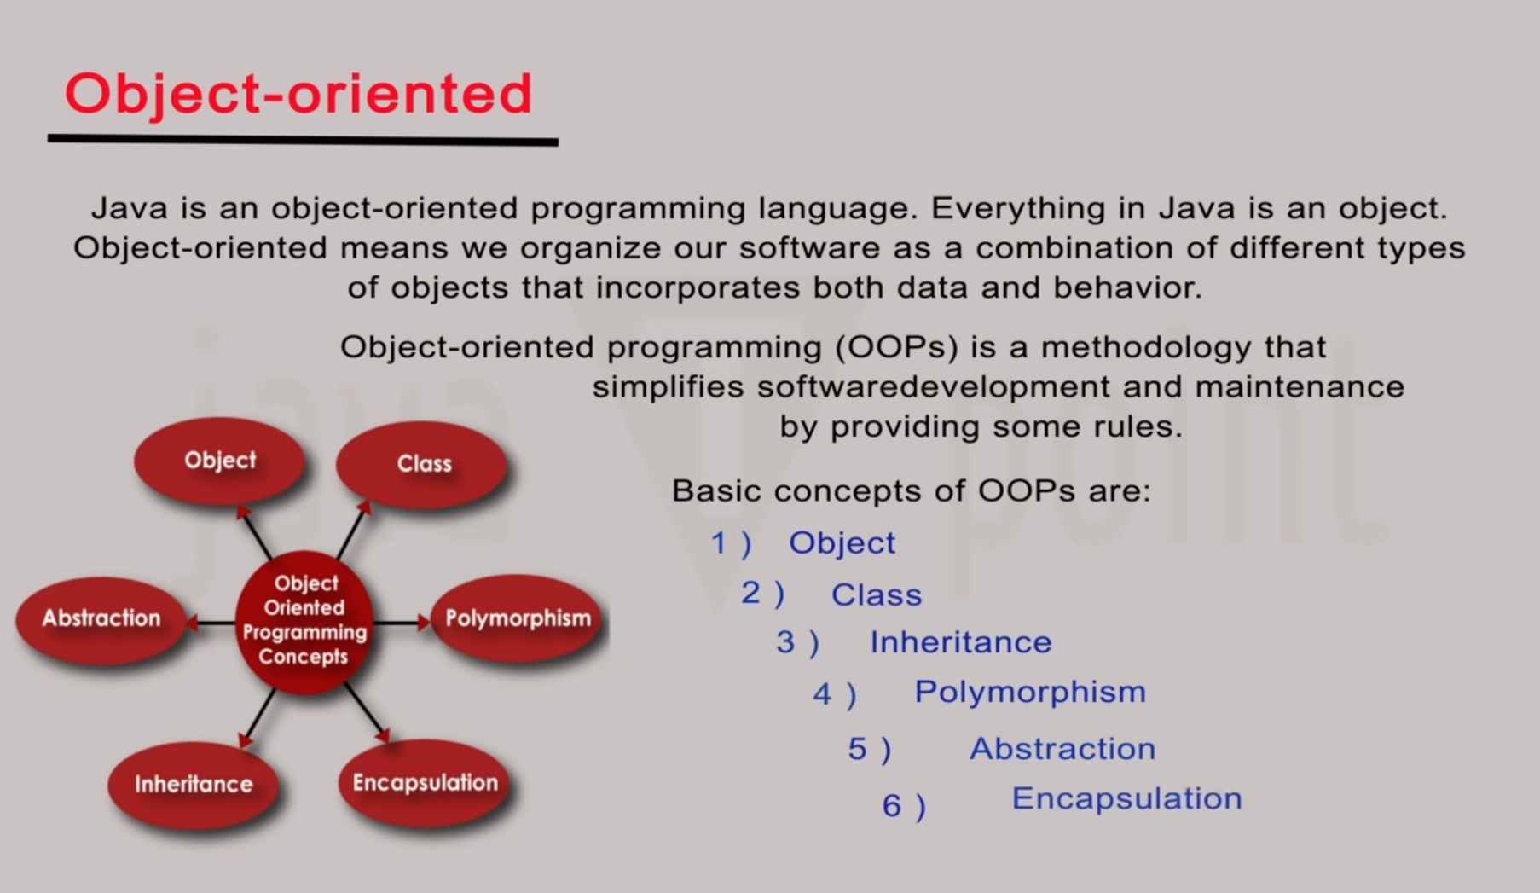

Slide 32
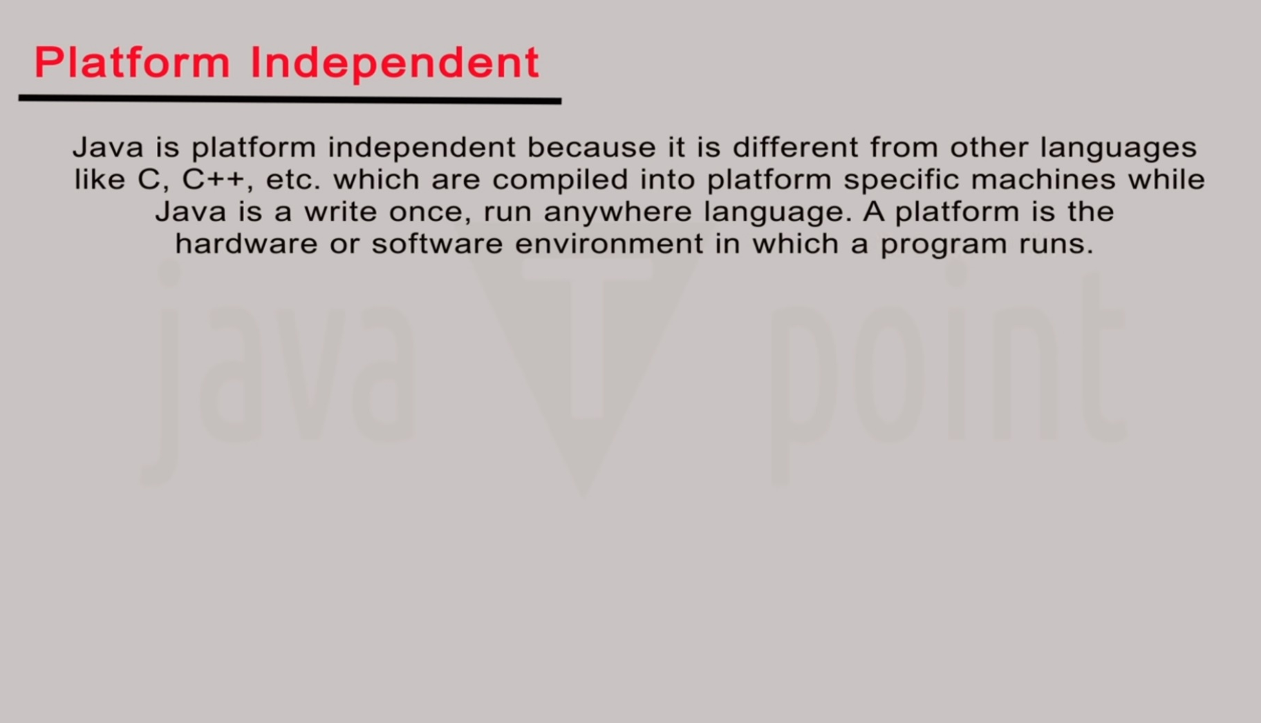
The biggest strength of Java is its platform independent nature.
Being platform independent means a program compiled on one machine can be executed on any machine of the wo Id without any change.
Java achieves platform independency by using the concept of BYTE code.

Slide 33
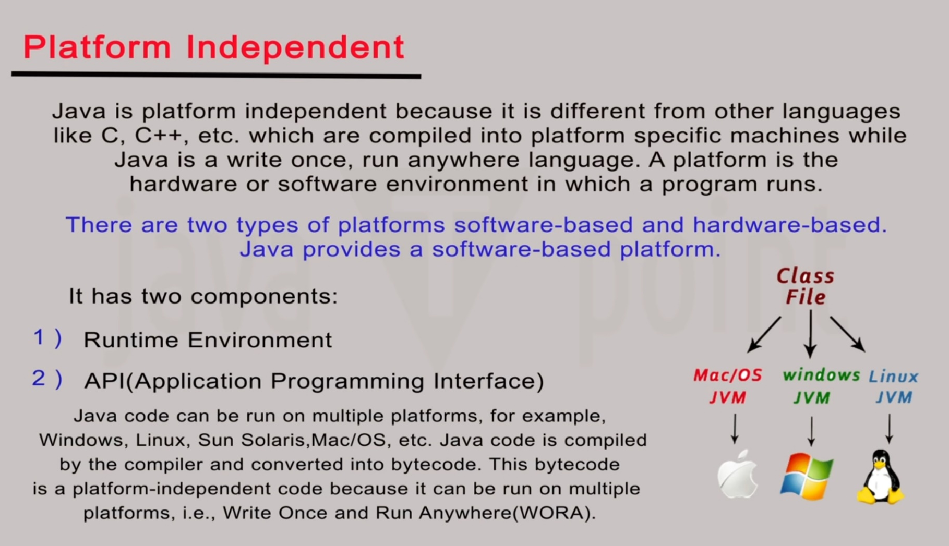

Slide 34
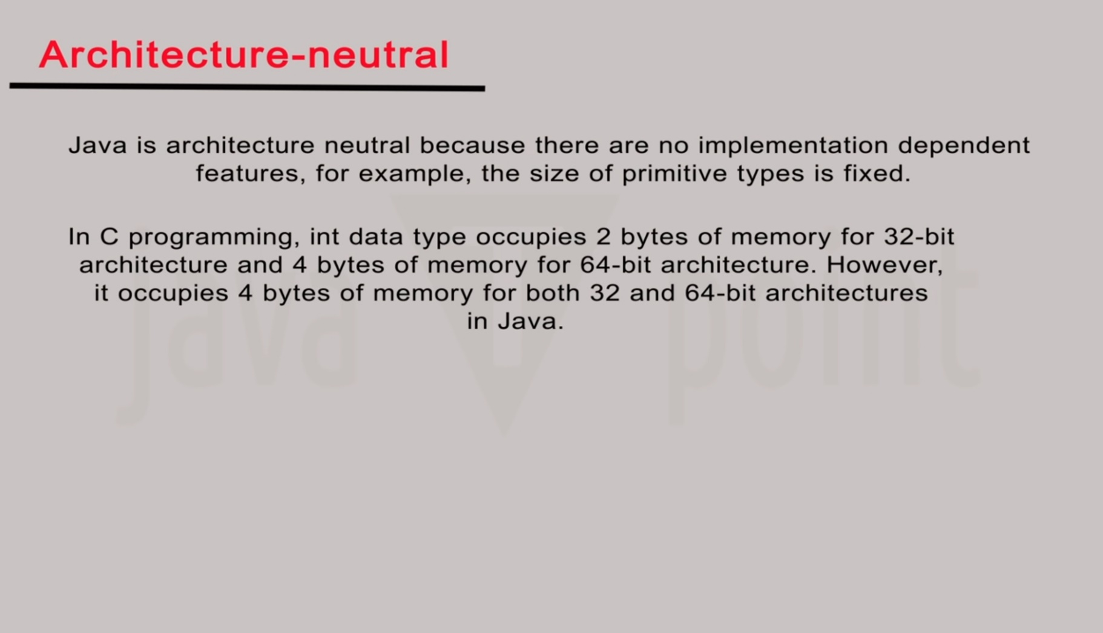
“Write once, run anywhere”
With a Java Virtual Machine (JVM), you can write one program that will run on any platform.

Slide 35
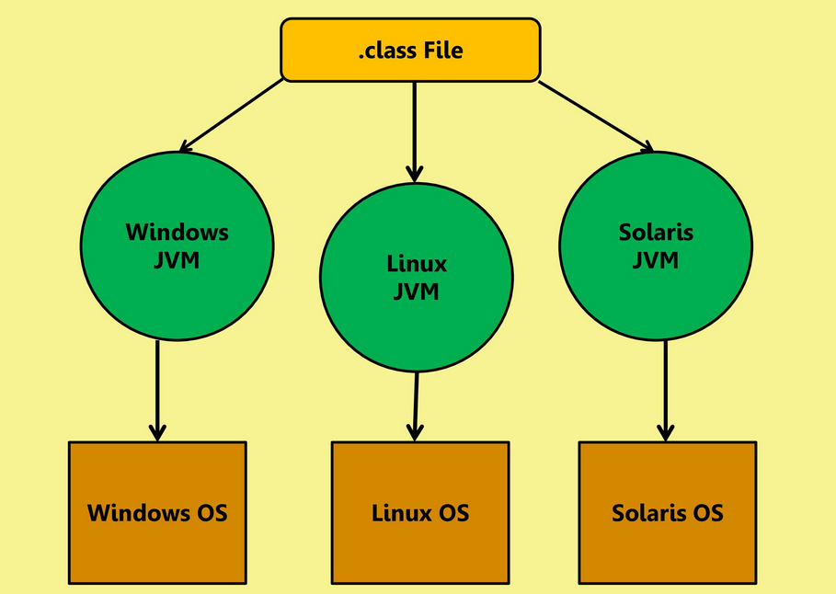
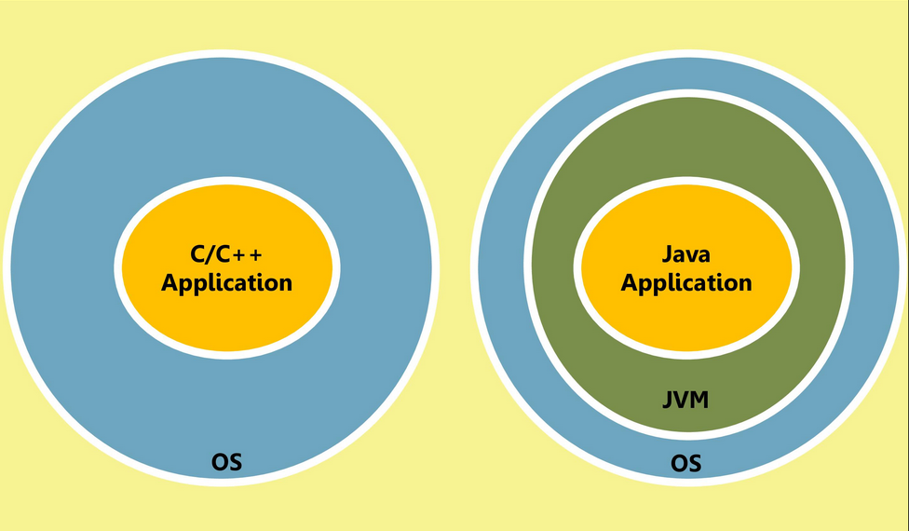
Platform independent/Architecture Neutral

Slide 36
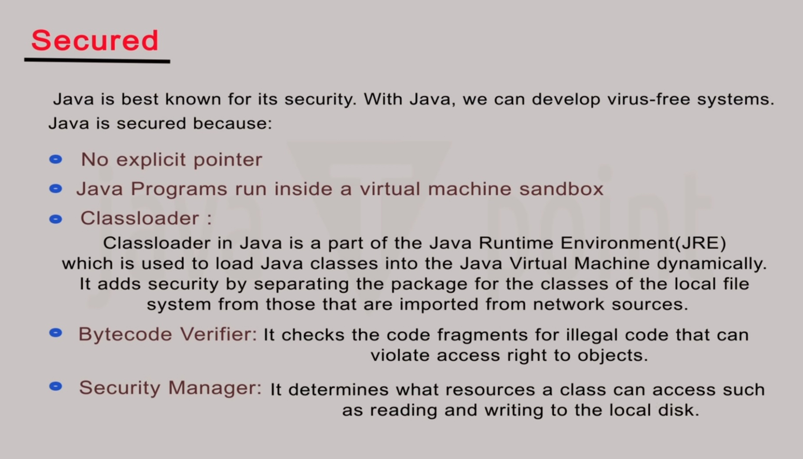

Slide 37
Robust
Robust (Fault Tolerance) In Java, any runtime error encountered by the Java is never passed on to the underlying system rather as soon as any such error occurs the JVM immediately terminates the program stopping it from causing any harm to the underlying system.
Thus we can say that Java is a robust language which does not allow any such operation by the program which can cause any kind of harm to OS.
Java has a runtime exception-handling feature to provide programming support for robustness.

Slide 38
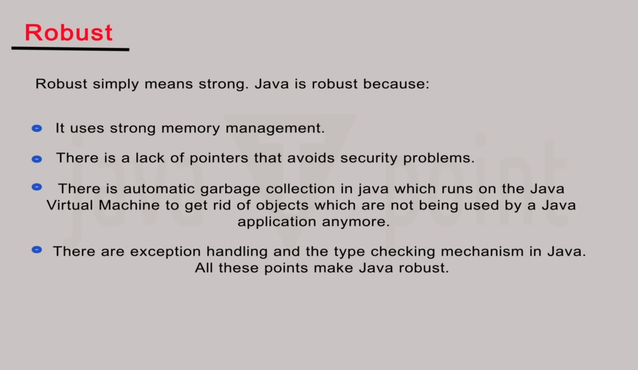

Slide 39
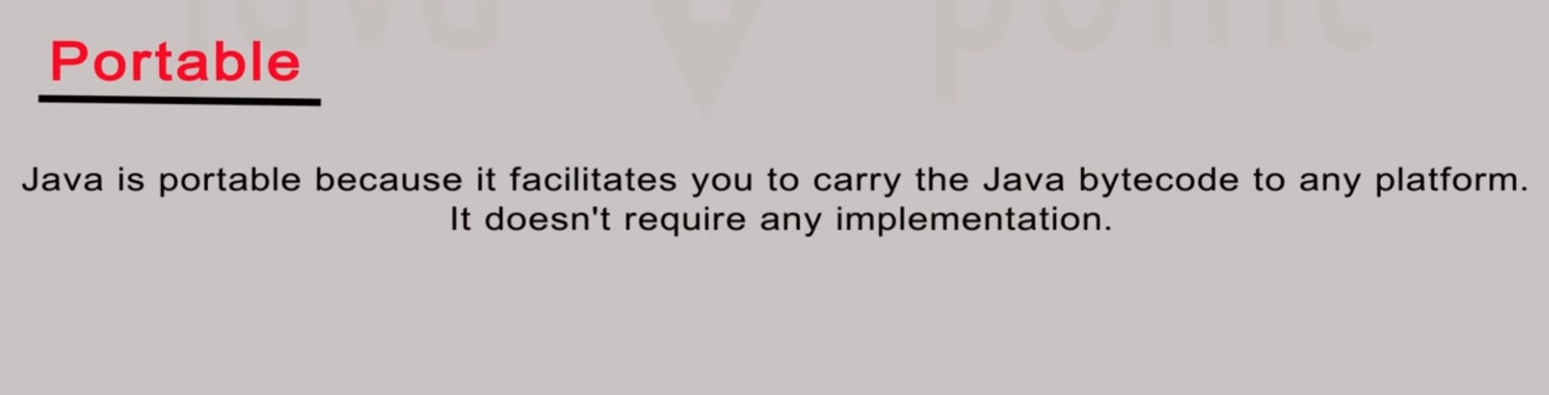

Slide 40
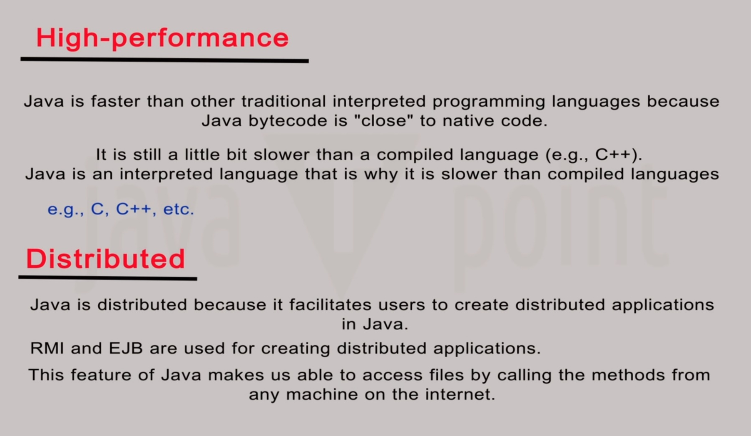

Slide 41
Multi-threaded
Multithreading means executing multiple portions (functions) of the same program in parallel.
Just like in Microsoft word, multiple functionalities take place at same time, like typing, spell check, grammar check, auto save, auto complete, office assistant etc...
Since all this is taking place inside MS Word, we can say that it is an example of multithreading.
Java is one of the pioneer language to support this concept.
Thus development of Multithreaded application is one of the important strength of Java.

Slide 42
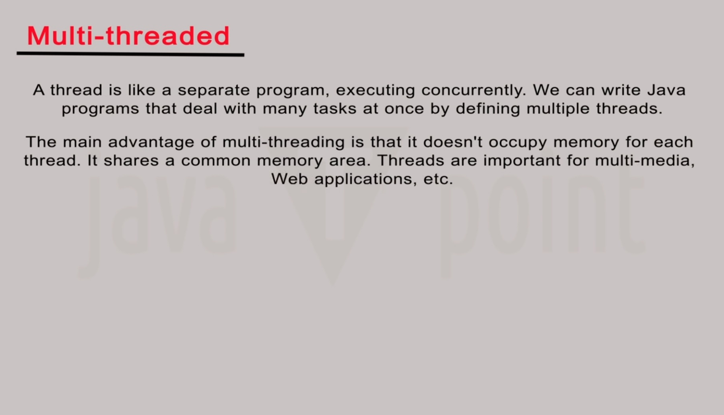

Slide 43
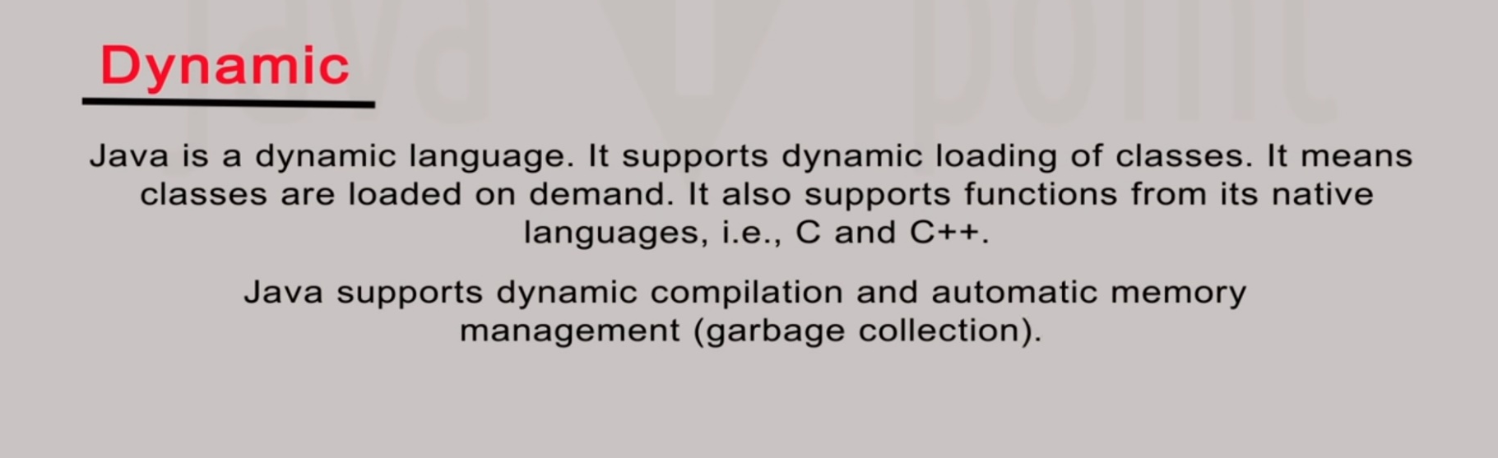
Java was designed to adapt to an evolving environment.
New code can be loaded on the fly without recompilation.
There is no need for developers to create, and for users to install, major new software versions.
New features can be incorporated transparently as needed.

Slide 44
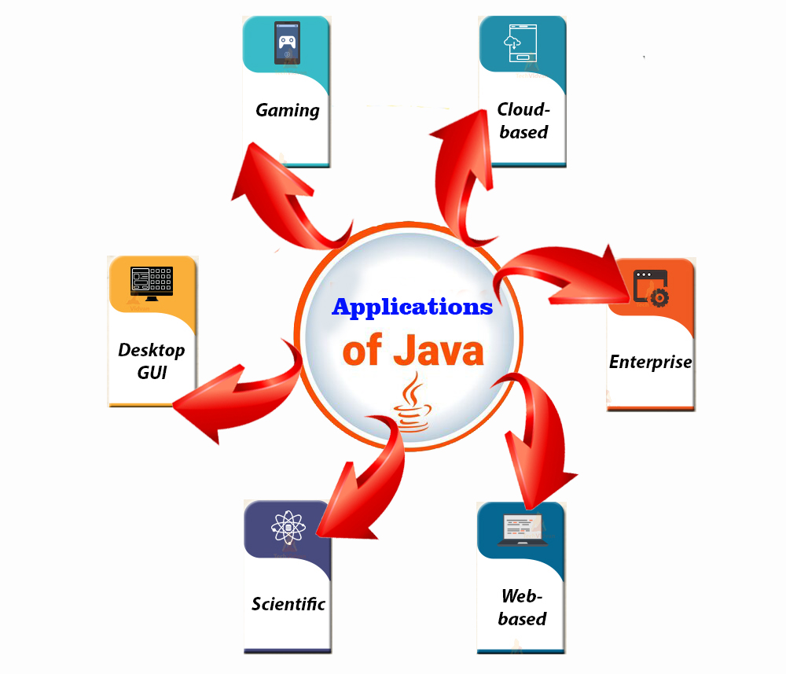

Slide 45
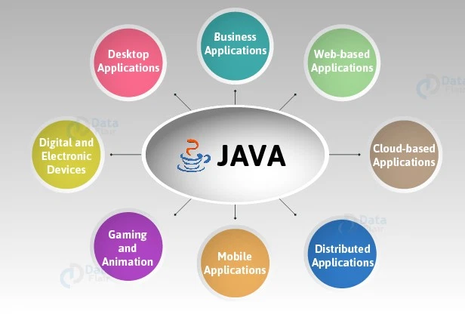

Slide 46
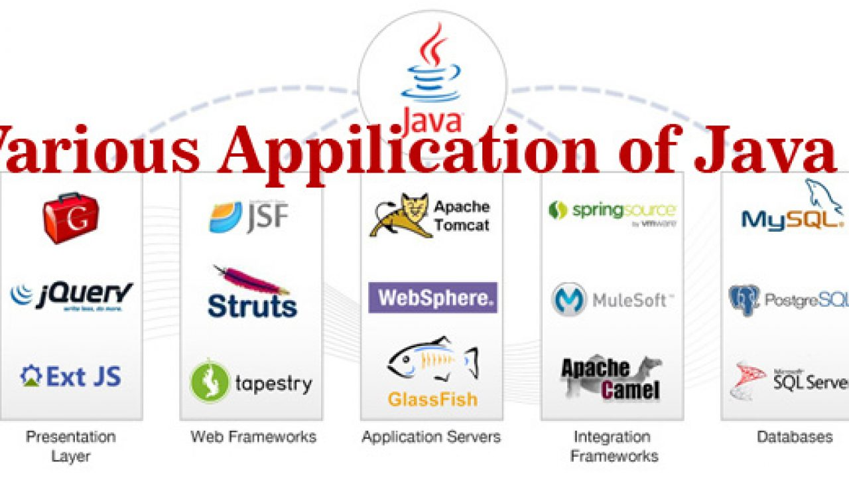

Slide 47
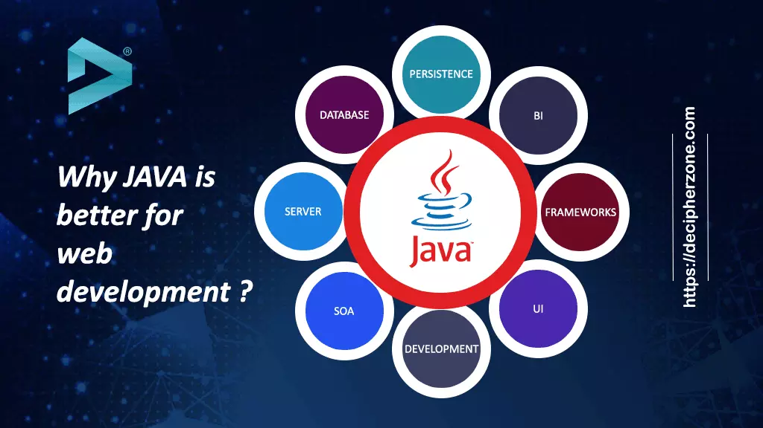

Slide 48
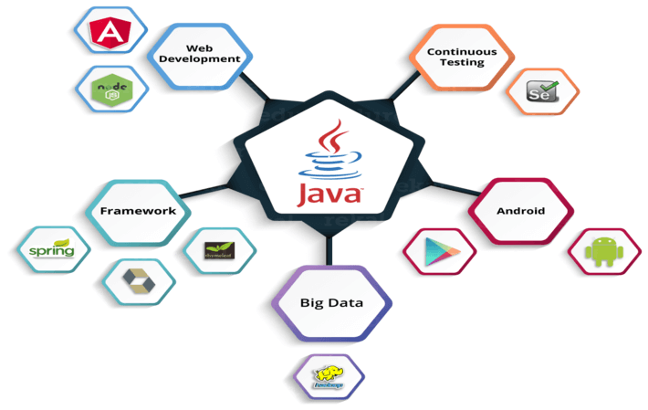

Slide 49
Structural approach: Java uses a hierarchical approach where the code is developed from bottom to top.
Strongly typed: Java is strongly typed where the system already knows and auto predicts when you are trying to pass a parameter/value to a component.
Object-Oriented: Code is developed in the form of components when they combine it makes an object like making spare parts to build a car.
Inheritance: The components made once can be reused with little or no modification
Encapsulation: Each component has its access filters i.e. Public, Private and Protected
Automatic memory management: Java has a garbage collection thread that automatically invokes on reaching a threshold and deletes temporary values that are already used.
Scalability: Java provides the flexibility to scale horizontally where new servers are added to increasing requirements.
Distributed architecture support: Java can work on distributed architecture where data is distributed on servers placed on different geographical locations.

Slide 50
Parallel architecture support: Where the same hardware can be used by multiple machines simultaneously.
Multithreading: Java can use multiple cores of servers simultaneously to provide better throughput and high speed.
Cross-Platform: Java can convert the same code to machine code for Unix, Linux, Windows, Android through JVM
Large Community: No problem in finding support if you face any issues
Security: Object orientation properties and encryption algorithms make Java more secure.
Future-ready: All the above pros make java future-ready to work with AI and machine learning
Presently Java and JavaScript have many systems to work. The majority of the objectives to give an edge to software engineers like Vue, React targets quick application advancement, and simplicity in alteration through Angular gives more highlights and huge code libraries.

Slide 51
JDK Editions
Java Standard Edition (J2SE)
J2SE can be used to develop client-side standalone applications or applets.
Java Enterprise Edition (J2EE)
J2EE can be used to develop server-side applications such as Java servlets and Java ServerPages.
Java Micro Edition (J2ME).
J2ME can be used to develop applications for mobile devices such as cell phones.

Slide 52
Popular Java IDEs
NetBeans Open Source by Sun
Eclipse Open Source by IBM

Slide 54
